Slide 1
CpE111
Introduction to Computer Engineering
Dr. Minsu Choi
CH 5: VHDL

Slide 2
Introduction to VHDL
VHDL: VHSIC ___________________________.
VHSIC: Very High Speed Integrated Circuit; Dept of Defense first used it.
VHDL is pronounced by just reading the letters. VHSIC, on the other hand, is pronounced as vis-hic.
VHDL is a CAD (__________________) tool for digital logic networks.

Slide 3
How to Describe a Module (or a Unit) in VHDL?
Define the block itself by giving it a name, and by specifying the input and output ports -> called “_____” statement.
Specify what the module actually does (i.e., how the outputs are related to the inputs) -> called “_________” statement.
Reserved words and defined symbols for VHDL are shown in next slide.

Slide 4
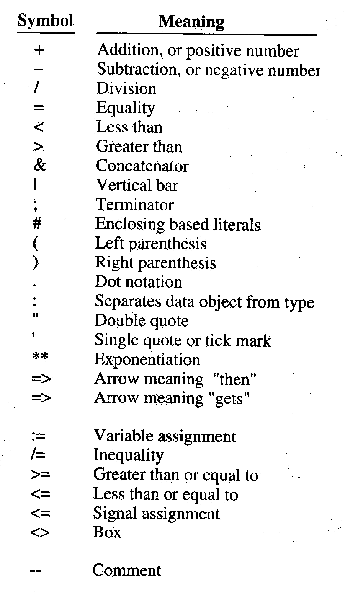
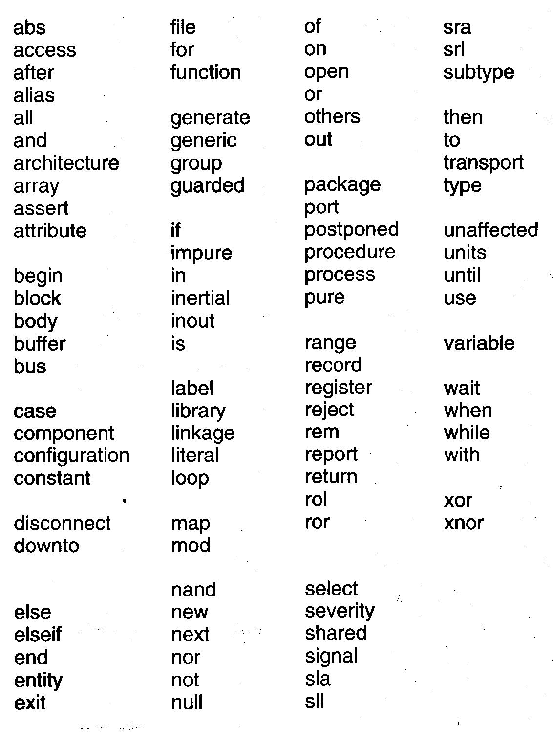

Slide 5
Entity Statement
Identifies the module as a distinct logic block and also defines the input and output ports.
Ex)

Slide 6
Architecture Declaration
Describes exactly what the block does.
Three major classifications for architectural declaration are:
  ___________________ where we provide an exact relationship between the inputs and the outputs.
  _______________ that construct logic functions by combining more primitive elements, such as gates.
  _____________ that describe modules by defining the “flow” of the data signals. This can be viewed as a type of behavioral model.

Slide 7
General VHDL Architectural Description Format
architecture type_of_description of gate_name is
Declaration_1;
Declaration_2;
…
begin
Statement_1;
Statement_2;
…
end type_of_description;

Slide 8
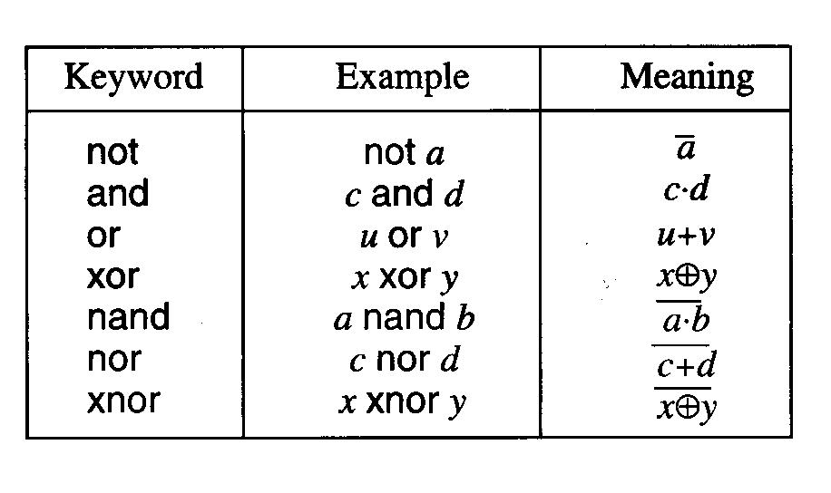
Ex) OR2 Gate

Slide 9
More Examples

Slide 10
Concurrent Operations
The keyword operators – not, and, or, xor, nand, nor, and xnor – are used to describe what are called “concurrent” operations -> operations are performed without regarding to any __________________.
f <= x and y and z; <- the value of f is updated whenever there is a change in the status of the inputs x, y and z.

Slide 11
Example

Slide 12
VHDL Identifier Rules
Upper and lower case letters + digits + underscore symbol “_” can be used.
Single string of characters of any length.
Case sensitive: Or_gate_3 is not the same as OR_GATE_3.
The underscore “_” cannot be used as the first & last character and not two or more “_”s in a row.

Slide 13
How to Specify Propagation Delay & Transport Delay?
No propagation delay is considered in concurrent operations.
To specify propagation delay, use “____” keyword along with the value of the delay in the concurrent operation statement.
Ex)
Transport delay: time delay associated with an ___________________.
Ex) output <= ___________ after 10ps;
This describes a signal x that is moved to the output after a delay of 10 pico seconds (1ps = __________).

Slide 14
Structural Modeling
Basic units can be combined to build more complex logic networks.
Building blocks are called _____________.
Ex) f = ab + cd -> two basic components can be used to build this function: AND2 and OR2.

Slide 15
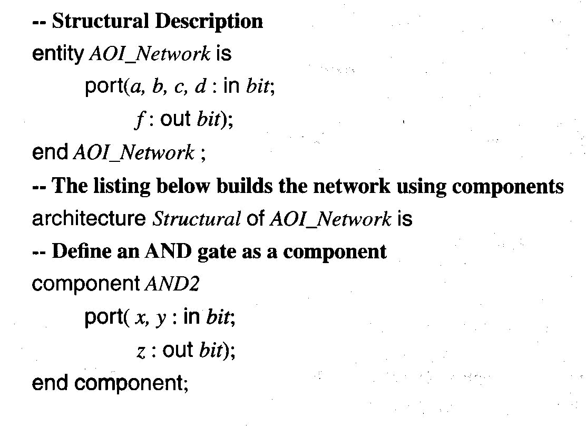
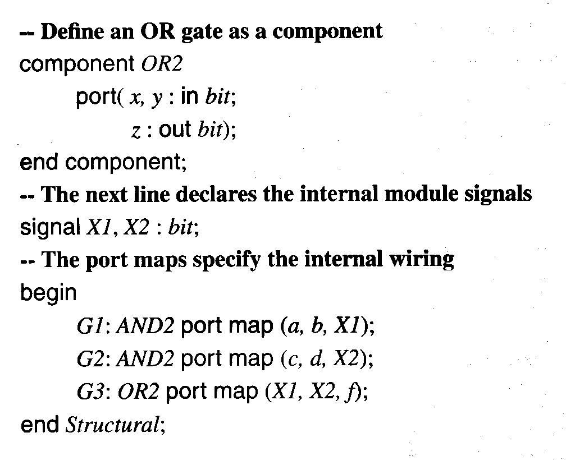
In VHDL…
In a design library which has AND2 and OR2 gates…

Slide 16
Modular Design using Cell Library
Choose cells (= unit gates) from a design library, then wire instances to build complex logic networks.
Ex)

Slide 17
VHDL Listing

Slide 18
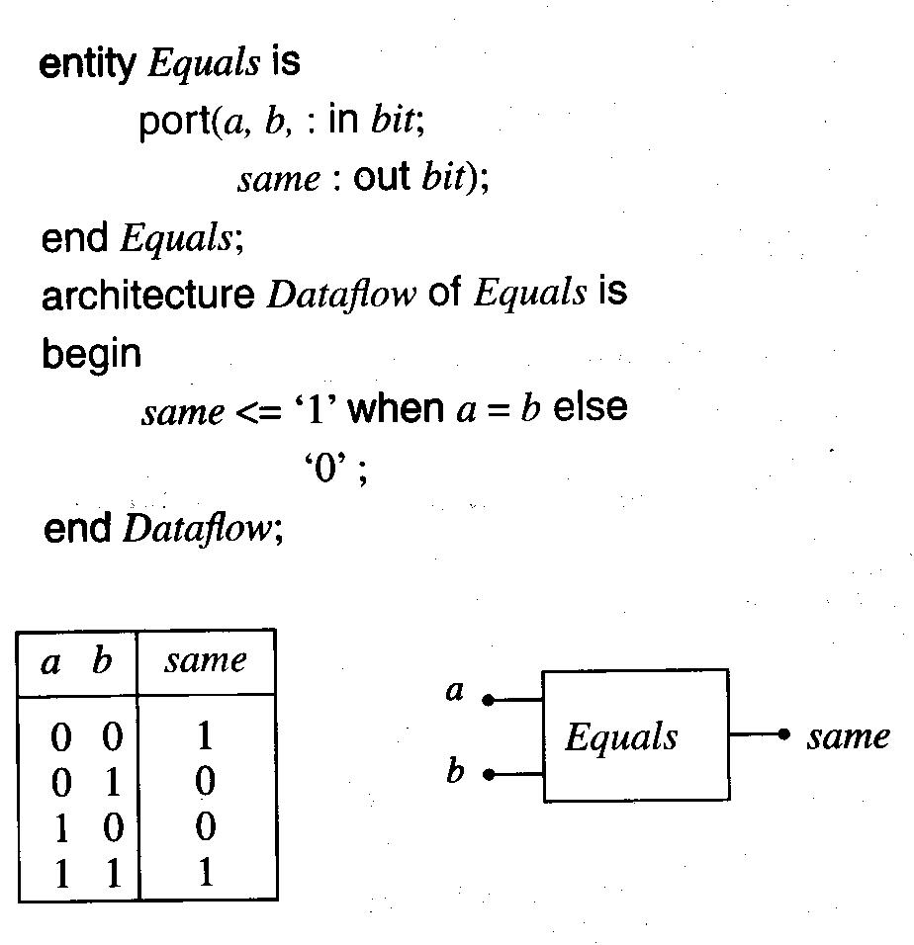
Conditional Models
VHLD conditional statement syntax: <statement1> when <condition> else <statement2>;
Relational Operators:

Slide 19
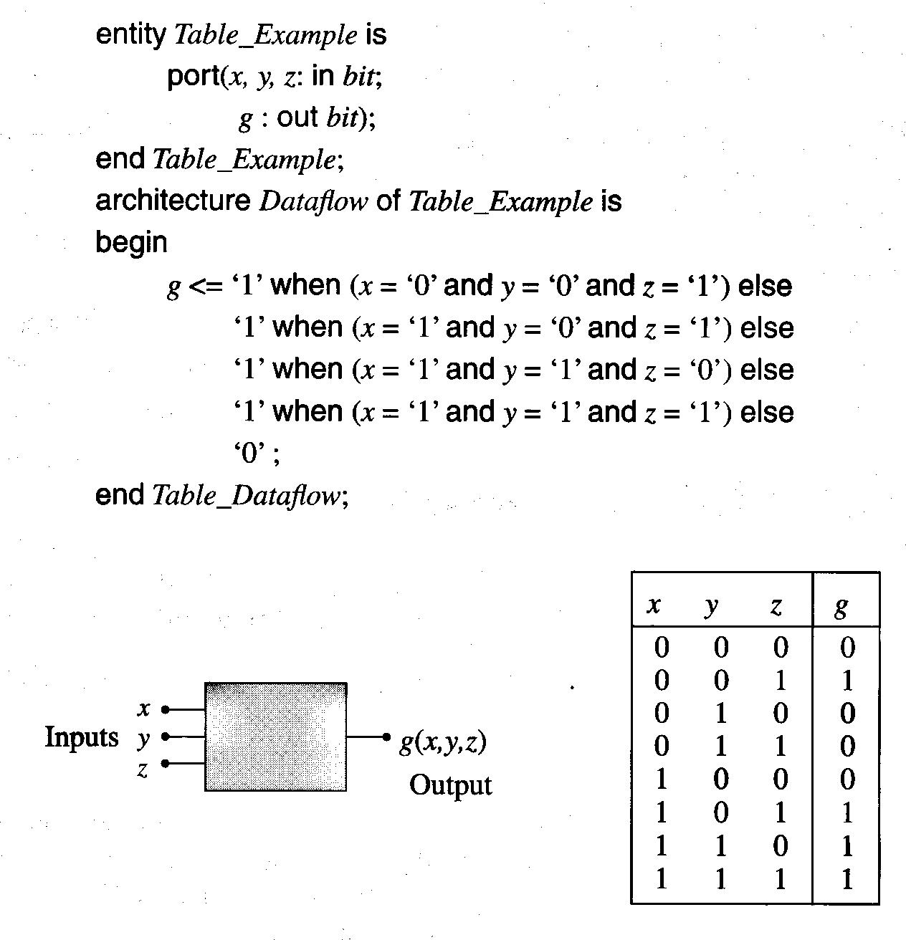
Example

Slide 20
Binary Words
n-bit binary word represent 2^n distinct bit patterns.
VHDL allows us to handle words using arrays of bits.
Ex) 4-bit word In_a = a₃a₂a₁a₀

Slide 21
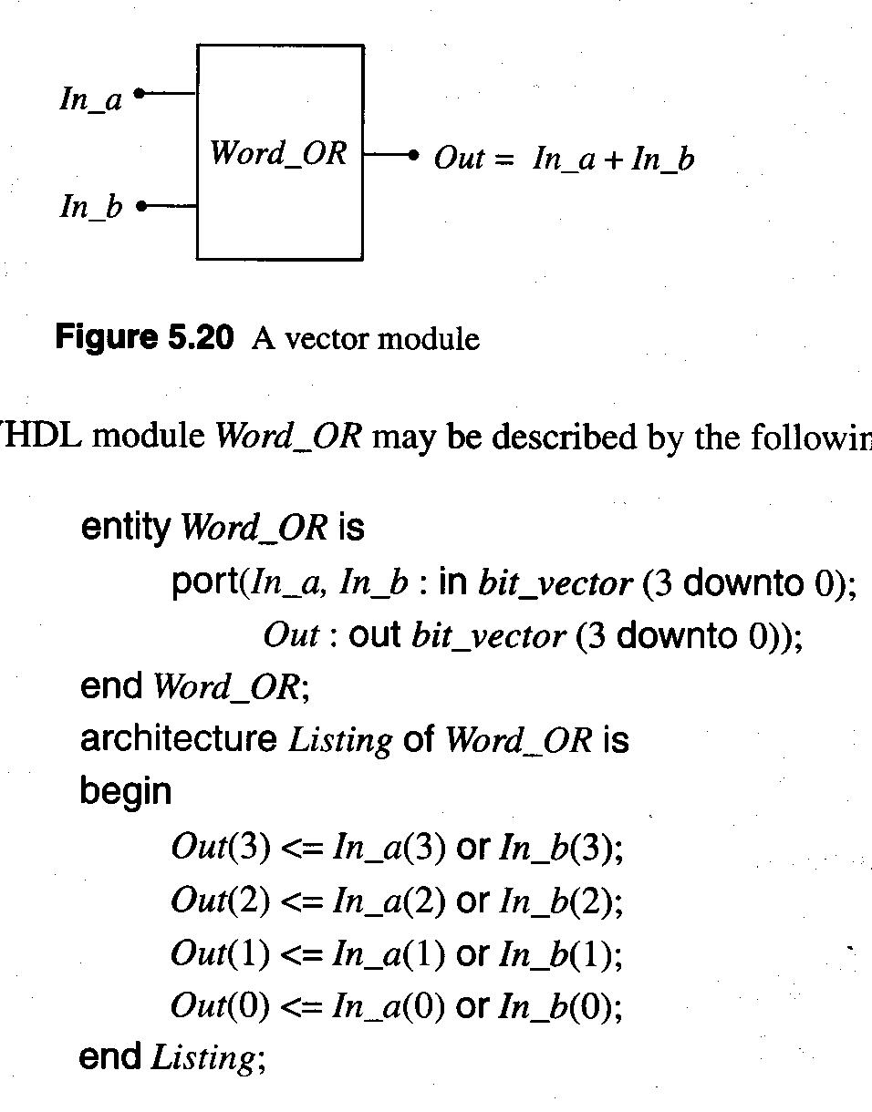
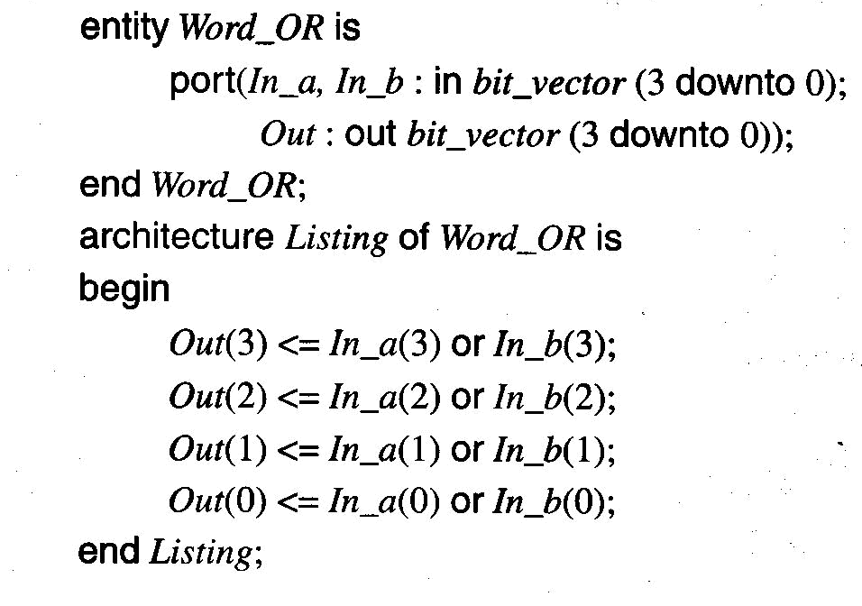
Ex) ORing Two 4-bit Words

Slide 22
Libraries
Library: collection of predefined ________ and _________ that are used by the VHDL compiler to interpret user’s code.
Packages: ________ of a library.
Ex) To introduce the ieee library and IEEE 1164 package, we initiate a VHDL description by;
library ieee;
use ieee.std_logic_1164.all;

Slide 23
Program Completed
University of Missouri-Rolla
© 2003 Curators of University of Missouri

